Slide 1

Placental Bioinformatics Course
Dr Russell S. Hamilton
Email: rsh46@cam.ac.uk
Twitter: @drrshamilton
Dr Xiaohui Zhao
Email: xz289@cam.ac.uk
Dr Malwina Prater
Email: mn367@cam.ac.uk
Course Materials:
https://github.com/CTR-BFX/2019-PlacentalBiologyCourse
License: Attribution-Non Commercial-Share Alike CC BY-NC-SA ( https://creativecommons.org/licenses/by-nc-sa/ )
Attribution: You must give appropriate credit, provide a link to the license, and indicate if changes were made.
You may do so in any reasonable manner, but not in any way that suggests the licensor endorses you or your use.
NonCommercial: You may not use the material for commercial purposes.
ShareAlike: If you remix, transform, or build upon the material, you must distribute your contributions under the same license as the original.
Version 0.1: 20190619

Slide 2
Program
Lecture 1: What is RNA-Seq?
Introduction to RNA-Seq and sequencer options
From Sequencer to Quality Control and Aligning reads
Practical 1:
From FASTQ to BAM
Lecture 2: Gene Counts to hypothesis testing
Experimental Design
Gene quantification
Differential Gene Expression Analysis
Practical 2:
BAM to DEGs
Russell S. Hamilton (rsh46@cam.ac.uk), Xiaohui Zhao (xz289@cam.ac.uk) & Malwina Prater (mn367@cam.ac.uk) 2

Slide 3
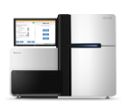
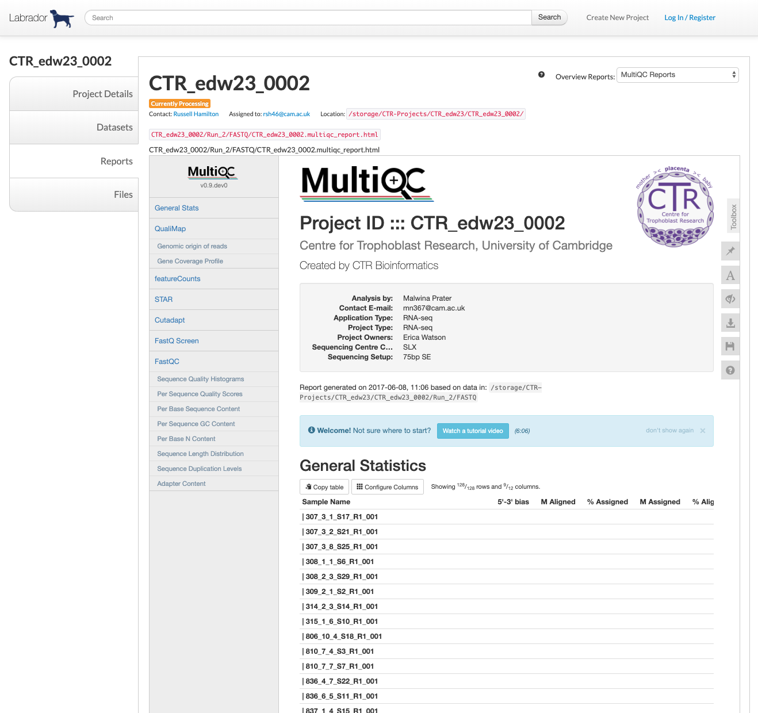
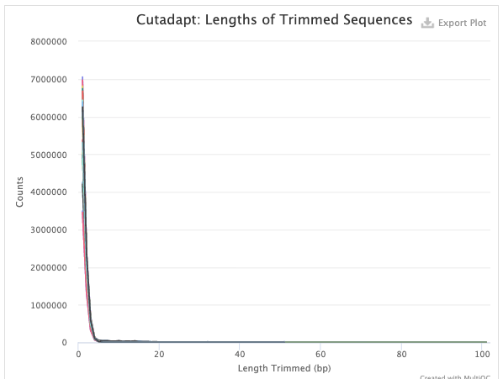
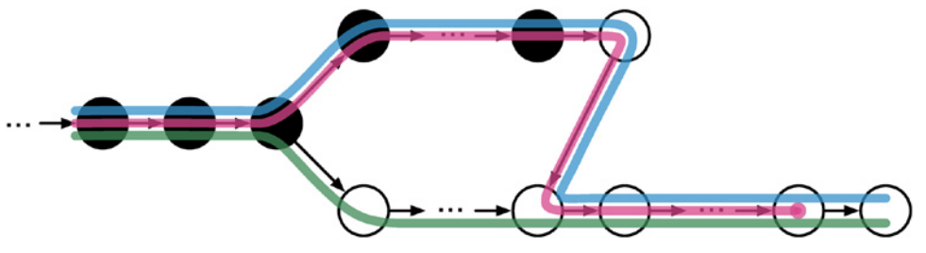
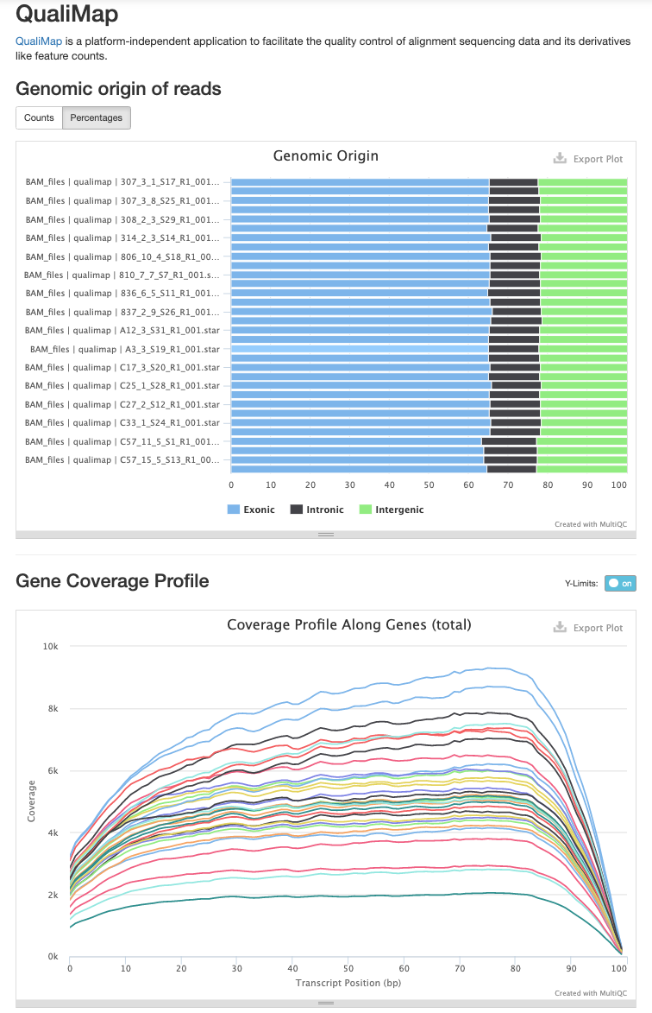
Program
Lecture 2: Gene Counts to hypothesis testing
Experimental Design
Gene quantification
Differential Gene Expression Analysis
Sequencer
FASTQ
QC
Trimming
Alignment
Summary
@K00254:75:HGHVHBBXX:1:1101:1550:1297 1:N:0:AACCAG
AATTTGCAGTAACTATTGCTGTTTTATTTAACAATGCCTTGTGACCAGTT
+
AAF-FJJJJFJJJJJJJJJJJJJJJJJJJJAJJJJJJJJJ<JJJJJJJJF
@K00254:75:HGHVHBBXX:1:1101:2057:1297 1:N:0:AACCAG
CAGTTTTTCAGCCTCCTGTTGCTTCTTTTGCTGTTCAGACTAAAAGAAAG
+
AAF-AFJJJJJJJJJJFFAFFJJJJFJJJJJJJJJJJJJJJJJJJJJJJF
@K00254:75:HGHVHBBXX:1:1101:2625:1297 1:N:0:AACCAG
AGACTTTACTTTCTGAGTTTTGTTTATTTTTTCCAATTTTCATAAATTTA
+
AAFFFJJJJJJJJJJJJAFJJJJJJJJJJJAJJJJJJJJJJJJJJJJJJJ
@K00254:75:HGHVHBBXX:1:1101:2666:1297 1:N:0:AACCAG
AGGTTTGACACATTTTCCTGGGGCTGCTCTTCACTGGTAGCCCATTCTGA
+
AAAAFFJJJJJJJJJJJJJJJJJJJJJ7FAAJJJJJJJFJJJJJFFJ<JJ
@K00254:75:HGHVHBBXX:1:1101:3011:1297 1:N:0:AACCAG
GTGATCAACAGCATTTATTTTCCCTTTTGAGGAACTGAAGAGTTGACAGC
+
AAFFFJJJJJJJJJJJJJJJJJJJJFJJJJJJJJJJJJJJJJJJJJJJJJ
@K00254:75:HGHVHBBXX:1:1101:3214:1297 1:N:0:AACCAG
GGAATACACTTTGTAACAGCAGTCTGCCAACCCTGAAGAAATTCAGGTCT
+
fastQC
Trim_galore
kallisto
multiQC
Russell S. Hamilton (rsh46@cam.ac.uk), Xiaohui Zhao (xz289@cam.ac.uk) & Malwina Prater (mn367@cam.ac.uk) 3

Slide 4
Differential Gene Expression Analysis
sample | condition
SRR1811706 | WT Yolk Sac
SRR1811707 | WT Yolk Sac
SRR1811708 | WT Yolk Sac
SRR1811709 | WT Yolk Sac
SRR1823638 | WT Placenta
SRR1823639 | WT Placenta
SRR1823640 | WT Placenta
SRR1823641 | WT Placenta
SRR1823642 | WT Placenta
SRR1823643 | WT Placenta
SRR1823644 | WT Placenta
4x YolkSac
Identify genes differentially expressed between the two groups
7x Placenta
Russell S. Hamilton (rsh46@cam.ac.uk), Xiaohui Zhao (xz289@cam.ac.uk) & Malwina Prater (mn367@cam.ac.uk) 4

Slide 5
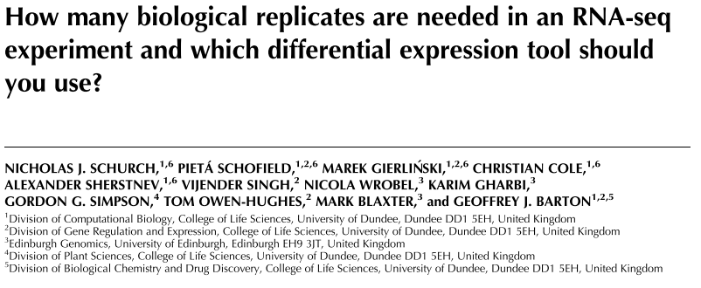
How Many Replicates?
Started with 48 replicates, removed replicated and investigated the power of statistical analysis
Conclusion/Recommendations:
Ideally at least six biological replicates should be used. Commonly three are used.
Rising to at least 12 when it is important to identify SDE genes for all fold changes.
If fewer than 12 replicates are used:
edgeR and DESeq2 the leading tools for DGE
https://doi.org/10.1261/rna.053959.115
Russell S. Hamilton (rsh46@cam.ac.uk), Xiaohui Zhao (xz289@cam.ac.uk) & Malwina Prater (mn367@cam.ac.uk) 5

Slide 6
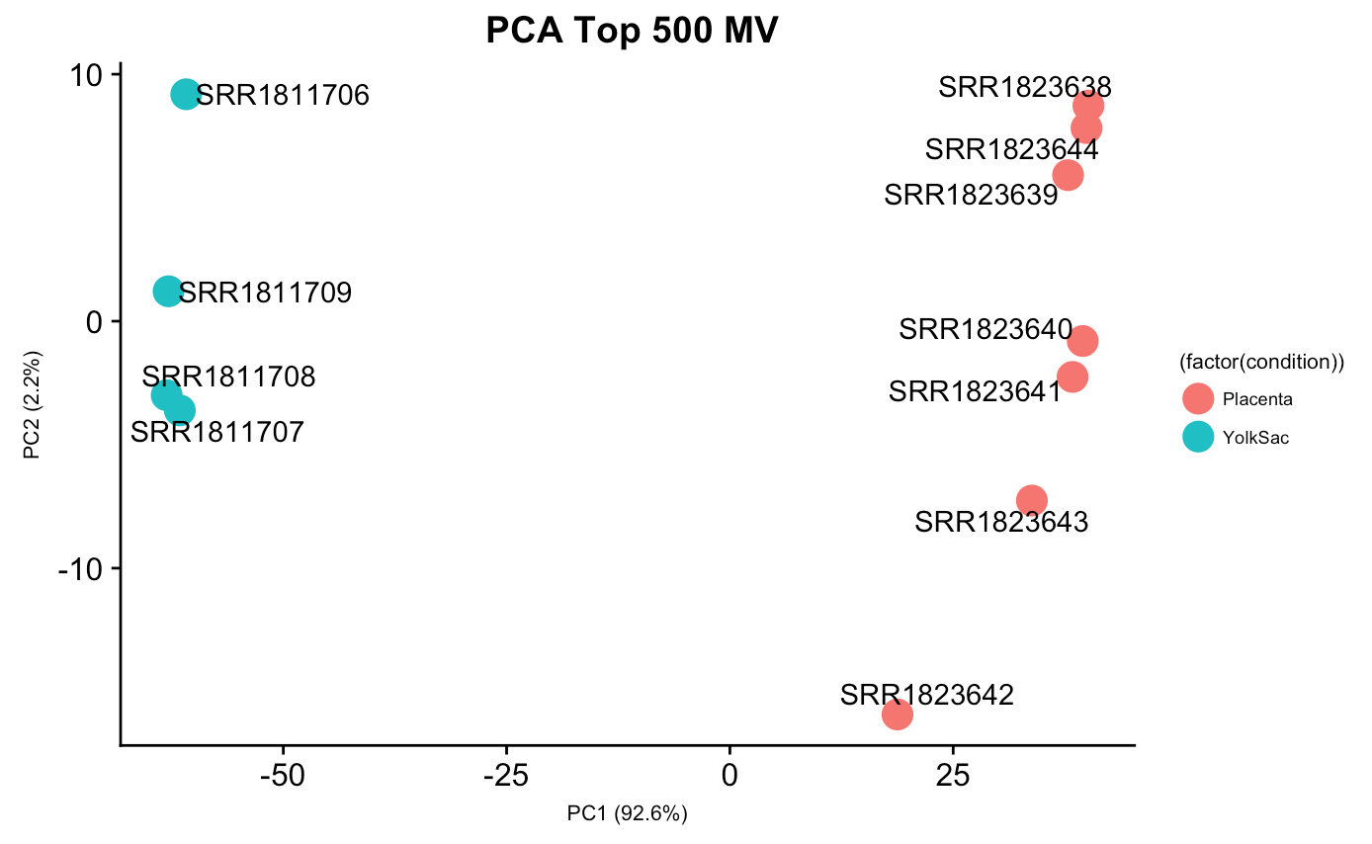
Differential Gene Expression Analysis
Principal Component Analysis
Do the samples cluster as expected?
Does the comparison make sense?
Is there a separation between groups?
Russell S. Hamilton (rsh46@cam.ac.uk), Xiaohui Zhao (xz289@cam.ac.uk) & Malwina Prater (mn367@cam.ac.uk) 6

Slide 7
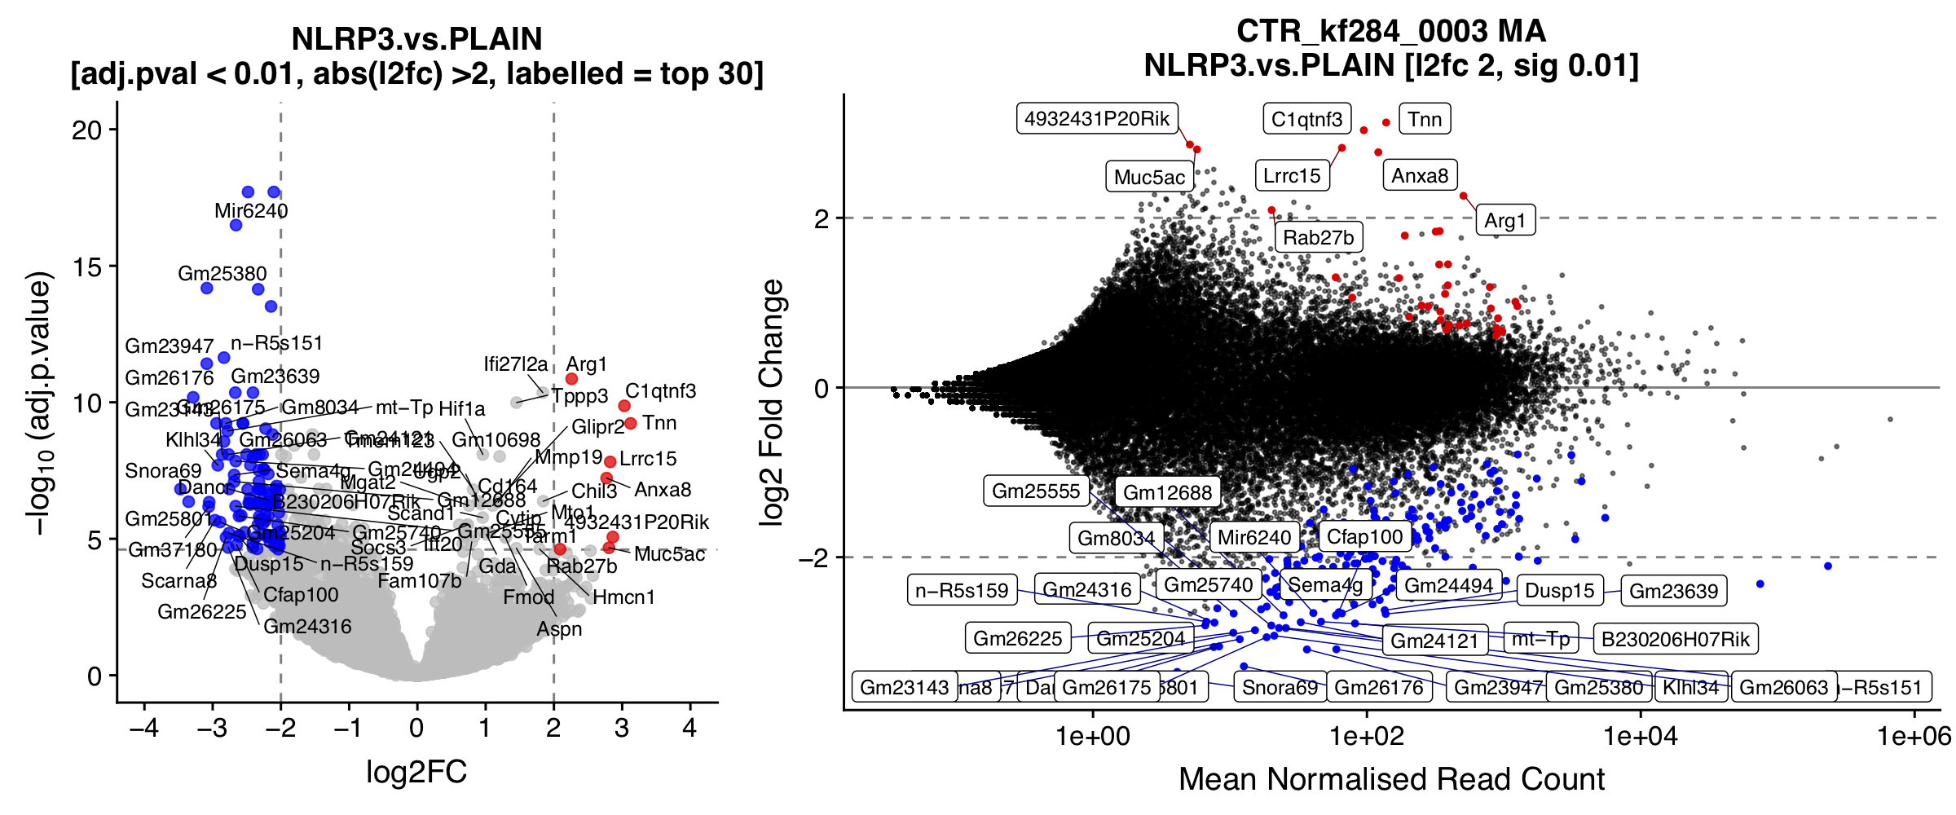
Visualising Differentially Expressed Genes
Volcano Plot
Mean/Average (MA) Plot
Heatmaps
Russell S. Hamilton (rsh46@cam.ac.uk), Xiaohui Zhao (xz289@cam.ac.uk) & Malwina Prater (mn367@cam.ac.uk) 7

Slide 8
Visualising Differentially Expressed Genes
Good to check the normalized counts of a gene identified to be differentially expressed
Russell S. Hamilton (rsh46@cam.ac.uk), Xiaohui Zhao (xz289@cam.ac.uk) & Malwina Prater (mn367@cam.ac.uk) 8

Slide 9
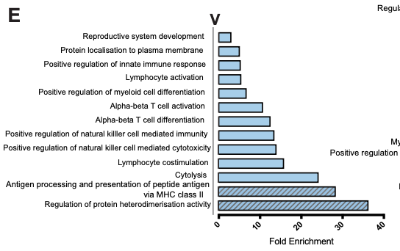
Gene Enrichment
Do the identified differentially expressed genes have anything in common?
Pathway enrichment
Protein Interactions
Compartment / Location
Filipovic, I, et al (2018) Molecular definition of group 1 innate lymphoid cells in the mouse uterus. Nature Communications, 9:1, 4492
Russell S. Hamilton (rsh46@cam.ac.uk), Xiaohui Zhao (xz289@cam.ac.uk) & Malwina Prater (mn367@cam.ac.uk) 9

Slide 10
Reproducible Bioinformatics
Versioning
If you write code or scripts use a versioning system (a bit like track changes in Word)
Make it publicly available so people can comment and submit bug reports
e.g. http://www.github.com
Pipelines
Track program version numbers, consistent processing and reporting
Avoid manual input of data or settings
e.g. http://custerflow.io or NextFlow
Data Repositories
Upload your published data to GEO, ENA, SRA etc
Russell S. Hamilton (rsh46@cam.ac.uk), Xiaohui Zhao (xz289@cam.ac.uk) & Malwina Prater (mn367@cam.ac.uk) 10

Slide 11
Dr Russell S. Hamilton Email: rsh46@cam.ac.uk
Dr Malwina Prater Email: mn367@cam.ac.uk
Dr Xiaohui Zhao Email: xz289@cam.ac.uk
Course Materials:
https://github.com/CTR-BFX/2019-PlacentalBiologyCourse
License: Attribution-Non Commercial-Share Alike CC BY-NC-SA ( https://creativecommons.org/licenses/by-nc-sa/ )
Attribution: You must give appropriate credit, provide a link to the license, and indicate if changes were made.
You may do so in any reasonable manner, but not in any way that suggests the licensor endorses you or your use.
NonCommercial: You may not use the material for commercial purposes.
ShareAlike: If you remix, transform, or build upon the material, you must distribute your contributions under the same license as the original.

